Slide 1

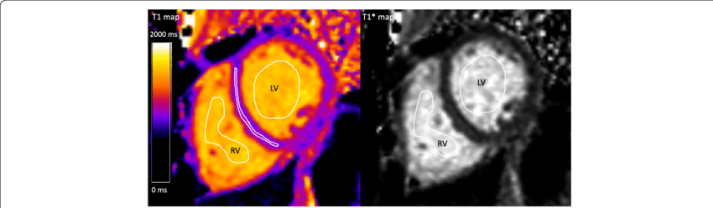
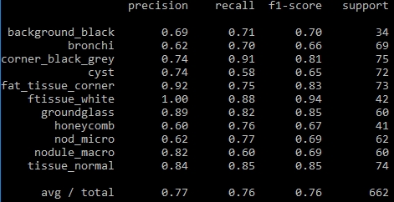
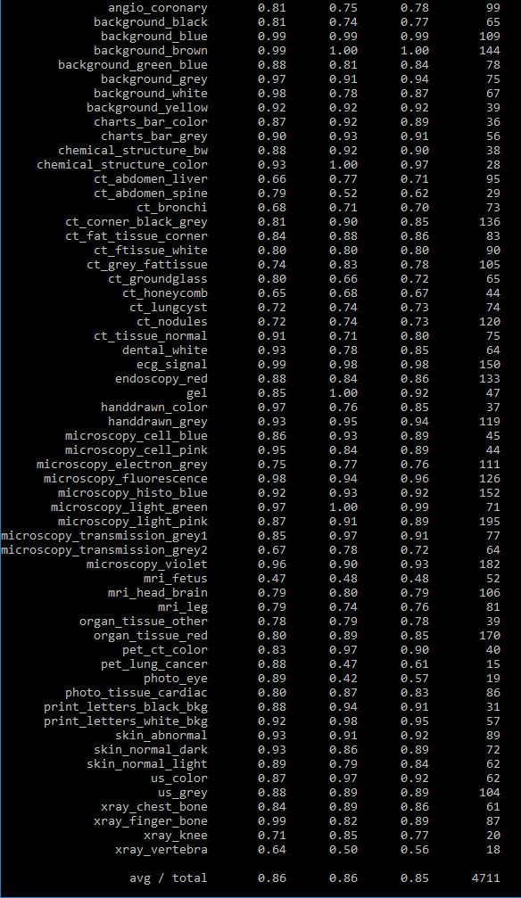
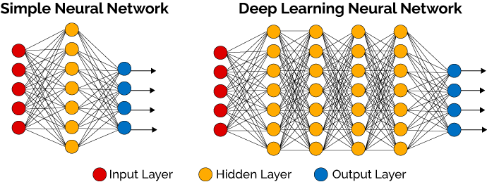
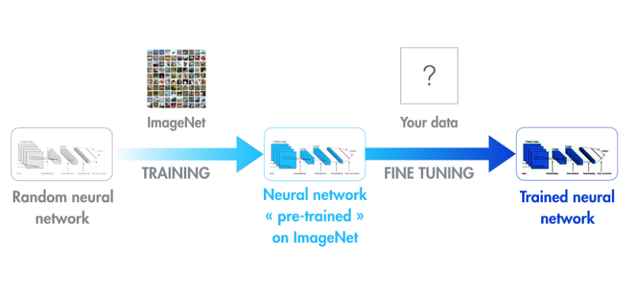








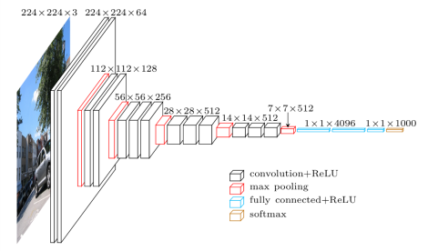
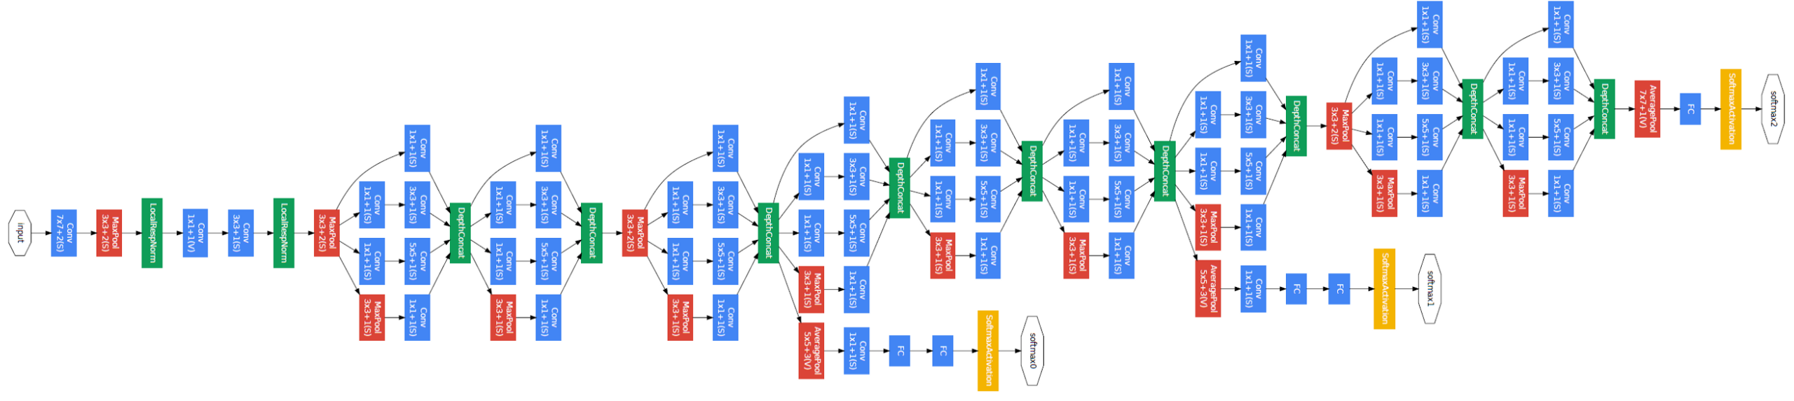
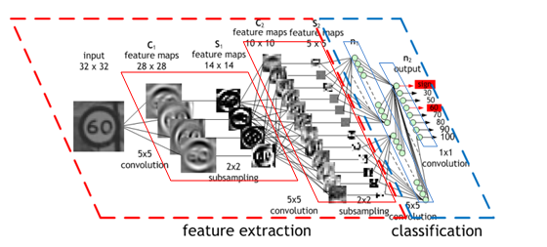
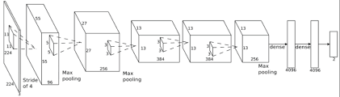
Classification and Detection of Lung Computed Tomography (Ct) Patches with Deep Feature Extraction by Transfer Learning Using Python
Jose Dixon, Mahmudur Rahman, Ph.D. (Mentor) Computer Science Department, Morgan State University, Baltimore, Maryland
Introduction
Deep Feature Extraction
Result Analysis
In biomedical articles, authors often use annotation markers such as arrows, letters, or symbols overlaid on figures and illustrations to highlight ROIs.
An author of a biomedical article might report on the characteristics of some nodules depicted in a patient’s lung CT scan, these as a basis for a possible cancer diagnosis.
Deep neural networks trained on large-scale datasets have demonstrated to be excellent at the task of transfer learning.
Images serves an input being processed
through layers.
Features can be extracted with a pre-trained CNN.
The features are written to model.
The features are extracted using a model using a pretrained CNN.
Results are compared together from three deep learning CNNs for two datasets.
Their three architectures tested individually from each other for two datasets.
VGGNet for CT_Chest_Patch
ResNet from MedPatch60
This Figure Shows Regions Of Interest Drawn in a Circle
Objective
Deep learning algorithms, such as convolutional neural networks (CNN) seem to be effective in providing better accuracy.
Using a pre-trained CNN as a feature extractor also provides an alternative to the hand-crafted features based on learning a transformation of raw data input to a representation that can be effectively exploited in general machine learning tasks, such as Random Forest or Support Vector Machine (SVM) Classifiers.
Transfer Learning
Transfer learning is a machine learning method where a model developed for a task is reused as the starting point for a model on a second task.
Transfer Learning uses pre-trained models that have been used for another task to jump start the development process on a new task or problem.
Transfer Learning can speed up the time it takes to develop and train a model by reusing these pieces or modules of already developed models.
Convolutional Neural Networks
CNN Architecture | Dataset | Precision | Recall | F1-Score | Accuracy (with crops) | Accuracy (no crops)
ResNet | MedPatch | 0.86 | 0.86 | 0.85
AlexNet | CTChest |  |  |  | 0.50 [rank-1] | 0.45 [rank-1]
GoogleNet | MedPatch |  |  |  |  | 0.72 [rank-1] 0.91 [rank-5]
VGGNet | CTChest | 0.77 | 0.76 | 0.76
Convolutional Neural Networks Architectures for Deep Learning: ResNet, GoogleNet, VGGNet, and AlexNet.
Each type CNN utilizes it own layers, kernels, and training techniques.
A typical convolutional neural network has a convolutional layer, pooling layer, fully connected layer, receptive field layer, and weights.
ResNet:
An architecture can be trained using standard Stochastic Gradient Descent (and a reasonable initialization function) through the use of residual modules.
GoogleNet:
An inception-based network and smaller form of GoogleNet.
It acts a multi-feature extractor by computing 1x1, 3x3, and 5x5 convolutions of levels
AlexNet:
Contained eight layers; the first five were convolutional layers, some of them followed by max-pooling layers, and the last three were fully connected layers.
VGGNet:
VGGNet architecture will accept images with spatial dimensions 64 × 64 × 3 (64 pixels wide, 64 pixels tall, and 3 channels).
Experiments
The experiment is conducted with the CT_Chest_Patch dataset having 2645 images with 12 different segmented CT lung patches and the MedPatch60 dataset with 18854 images with 60 different modalities. 80% images was used for the testing set and 20% for training set.
Accuracies are compared using different classification techniques by using VGGNet, AlexNet, GoogleNet, and ResNet convolutional neural network architectures.
Segmented Images of CT_Chest_Patch Dataset
Conclusion & Future Work
Deep learning can help address the problems that machine learning failed to resolve or provide the best results for.
We will attempt do more deep learning on the following dataset with ranked accuracy, improved techniques, advanced optimization methods.
This work will be used to test with additional convolutional neural networks to evaluate the effectiveness for image processing.
Segmented Images of MedPatch60 Dataset
Deep Learning Algorithm
For Image Processing and Classification, Python 3.6 , OpenCV 3.4, and Keras libraries were used.
References
ResNet
VGGNet
Images serve as input for image processing in deep learning.
The convolutional neural network serve as the feature extractor and classifier simultaneously (as compared to sequentially in machine learning.
Majority of the layers serve as feature extractors before going to final layer of the algorithm.
Herrera, Alba Garcia Seco, and Jayashree Kalpathy-Cramer. “AMIA: Medical task.” ImageCLEF / LifeCLEF - Multimedia Retrieval in CLEF, ImageCLEF, 29 Oct. 2017, www.imageclef.org/2013/medical.
“Modern Machine Learning Algorithms: Strengths and Weaknesses.” (2018, May 20). https://elitedatascience.com/machine-learning-algorithms (accessed 6 August 2018)
Rahman, M., Antani, S. K., & Thoma, G. R. (2010). A classification-driven similarity matching framework for retrieval of biomedical images. 2010 Proceedings of the International Conference on Multimedia Information Retrieval, 147-154.
Simonyan, K., & Zisserman, A. (2014). Very Deep Convolutional Networks for Large-Scale Image Recognition,Abs/1409.1556. http://arxiv.org/abs/1409.1556 (accessed 26 August 2018)
AlexNet
GoogleNet

